Slide 1
EnPe Academic Seminar
Trondheim Norway 2019
Anthei/EnPe II Project – An Overview
Prof. Jon Kleppe - Overall project coordinator
Dr. Ambrose Itika – UDSM project coordinator
Prof. Egil Tjäland – NTNU member
26th February 2019

Slide 2
Outline
Background
Part I
  The Anthei project
Part II
  The Anthei-EnPe II project

Slide 3
Background
Angola is among the large petroleum producers in Africa
Training of experts is limited
Tanzania announced large discoveries of natural gas in 2011
Prior to that there was little training in petroleum sciences
Sudden demand for experts
Suddenly the need for capacity building became huge

Slide 4
Part I – The Anthei Project
ANTHEI stands for Angolan, Norwegian, Tanzanian Higher Education Initiative
Program started in 2011 (3yr project)
Three Universities involved
  NTNU, UDSM and UAN (Augustinho Netto)
Supported for the 1st year by
  EnPe
  Statoil Tanzania and
  Statoil Angola.
The students do course work at NTNU and conduct research for dissertation at UDSM

Slide 5
Part I cont.
19 MSc students were admitted in August 2012.
One Ph.D. candidate from Angola was admitted in 2011
Orientation for all courses done at UDSM
Important feature – industry collaboration with EnPe

Slide 6
Part I cont.
In 2013 and 2014 the program was supported only by Statoil Tanzania and Statoil Angola
22 Students admitted for MSc (2013-14)
  18 from Tanzania
  4 from Angola
Between 2014 and 2016 participation by Angola further declined
Angola stopped in 2016

Slide 9
Overall number trained through Anthei/EnPe
A total of 78 M.Sc. students have been admitted to NTNU as part of the ANTHEI – EnPe program during the time period of 2012-2017, of which 14 are from Angola and 64 from Tanzania. In addition 3 Ph.D. candidates were admitted, 1 from Angola and 2 from Tanzania

Slide 10
Part II Anthei-EnPe II
Anthei-EnPe II project
Title
  “Capacity Building to Enhance Teaching/Learning, Research and Expert Services in Petroleum Sciences and Engineering in Angola and Tanzania”
Project approval
  2014
Commencement
  2015

Slide 11
Project objective
To improve the key skills in the upstream and midstream sectors:
  Human resource development
  Curriculum development (MSc PE and Geoscience)
  Training, staff exchange,
  Enhancement of research and knowledge exchange,
  Improvement of infrastructure (equipment and facilities) and
  Establishment/strengthening of links and collaboration.
  Quantify Factors affecting girls in science (Gender issues)

Slide 12
Project achievements
  Human resource development for Tanzania
Year | Admitted | Programme |  |  | Sponsor | Status | Fe total | Fe EnPe
 |  | Eng. | Geo. | Proj. Manag.
2012 | 10 | 8 | 2 | - | 10 EnPE | Complete | 5 | 5
2013 | 9 | 4 | 5 | - | Statoil | Complete | 3
2014 | 9 | 6 | 3 | - | Statoil | Complete | 1

Slide 13
Project achievements cont.
Human resource development Tanzania cont.
Year | Admitted | Programme |  |  | Sponsor | Status | Fe total | Fe on EnPe
 |  | Eng. | Geo. | Proj. Mngt.
2015 | 9 | 7 | 2 | - | 6 Statoil/ 3 EnPe | Completed | 1 | 1
2016 | 13 | 7 | 3 | 3 | 9 Statoil/ 4 EnPe | At UDSM for dissert | 4 | 3
2017 | 14 | 10 | 1 | 3 | 7 Statoil/ 7 EnPe II | At NTNU for course work | 5 | 3
Total | 64 | 42 | 16 | 6 |  |  | 17 | 12

Slide 14
Project achievements cont.
  Human resource development for UDSM
  Two (2) PhD for academic staff members and
  Eleven (11) MSc for academic staff members
  Planned short training for academic staff, staff exchange in teaching, learning and research.
  University of Agostinho Neto (UAN)
    One (1) PhD for staff and
    Five (5) Masters

Slide 15
Project achievements cont.
  Human resource (Technical staff).
  Two (2) Laboratory Engineers sent to NTNU for short training in laboratory management
  4 Laboratory Engineers sent to University of Cape Town for short training
  Two (2) more Laboratory Engineers sent to NTNU for short training

Slide 16
Project achievements cont.
Curriculum development UDSM
  MSc for Petroleum Geoscience running
  MSc curriculum for Petroleum Engineering sent for accreditation (TCU)
  MSc Petroleum Engineering scheduled to start in 2019
  UDSM started their own Licenciatura Program in Petroleum Engineering, Petroleum Geology and Petroleum Chemistry in 2013, with the first cohort of 21 BSc’s PE graduated in 2017
  These will feed into the MSc programs

Slide 17
Project achievements cont.
Enhancement of research capacity
  The PhD students and the MSc students have conducted research in various areas including:
  Multiphase flow systems, fluid dynamics modelling, characterization of reservour fluids, history matching, performance prediction, production characterization etc.
  More research equipment to be ordered

Slide 18
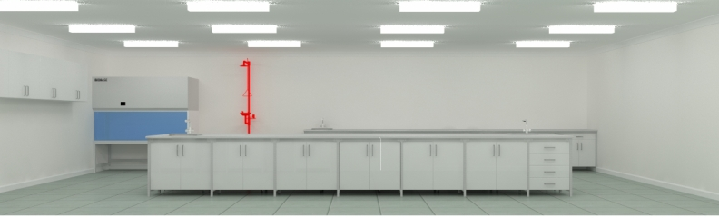
Project achievements cont.
Improvement of infrastructure
  High speed internet switch and wireless (WiFi) receivers have been installed in the department
  Laboratory facilities (porosimeter, furnace, oven)
  ICT facilities (computers, laptops, multifunction printers, multimedia have been procured)
Industrial partner supported new lab

Slide 19
Project achievements cont.
  Statoil to provide test rig for training and research
  Statoil to supply more laboratory equipment through NTNU

Slide 20
Project achievements cont.
Links and collaboration
  The dept has attracted powerful collaborators eg
  ExxonMobil, PURA, PanAfrican Energy, TPDC, Ministry of Energy, Uni CapeTown etc. and of course EQUINOR
  Statoil/Equinor financed all summer school activities for 5 years
  Statoil/Equinor organized and financed experts to conduct seminars/workshops
  ExxonMobil offers 12 scholaships to UG students every year

Slide 21
Project achievements cont.
Research on Gender issues
  Focussed on factors influencing girls in science
  Over 900 questionnaires filled
  63 secondary schools from 19 regions involved
  Data has been compiled
  Analysis done using SPSS
  The report is out
  Girls are academically very capable
  Social/economic factors seem more significant
  Cultural influences are very strong

Slide 22
Project output cont.
Links collaborations cont.
  Synergies with other projects:
    EU project
    Equipment procured (rheometer and contact angle goniometer)
    Academic staff got short training at Aberdeen University

Slide 23
Challenges
Few PhD holders in Petroleum Engineering
UDSM lacks middle aged senior staff (big age gap between senior and junior)
Procurement is very slow and cumbersome – orders are not executed in time
Industrial activities have been on low profile for the last 5 years
Existing laboratory facilities outdated
Delays in data acquisition – confidentiality agreements

Slide 24
The Future
Finalize the last batch of MSc 14 students
Initiating the MSc Petroleum Engineering
Secure more short courses for staff
Seek opportunities for PhD
Forging more links with industry
Strengthen ties with NTNU
Forging more links with other Universities

Slide 25
Conclusion
Despite the challenges, the project has been very successful. The program has been the pioneer source of the current emerging expertise in petroleum sciences and engineering in the country.

Slide 26
THE END
THANKS FOR LISTENING

Slide 27
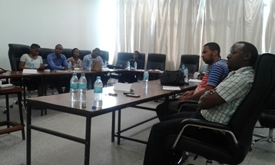
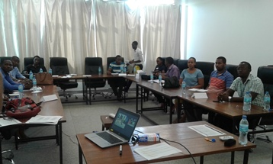
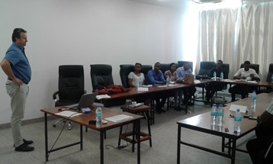
2017 Candidates in a session

Slide 28
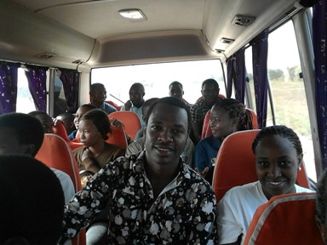
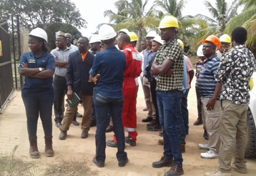
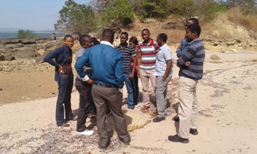
2016 Candidates on a field trip

Slide 29
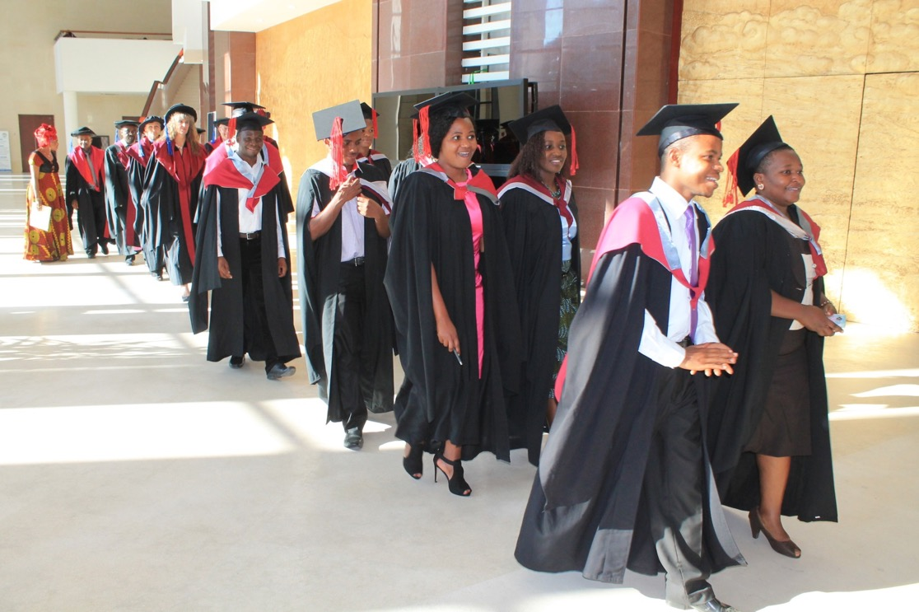
Anthei 1st Batch Graduates

Slide 30
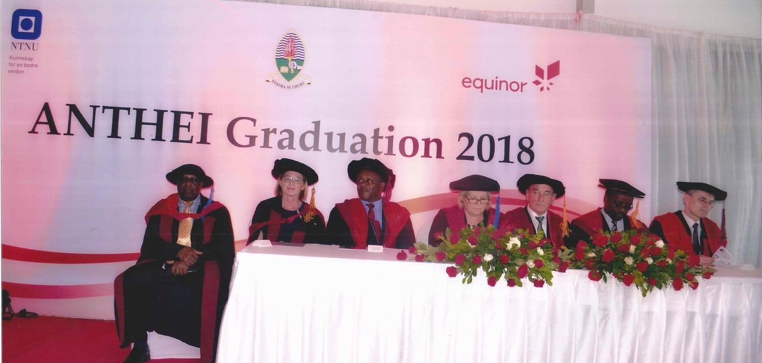
Fifth Anthei-EnPe Graduation

Slide 31
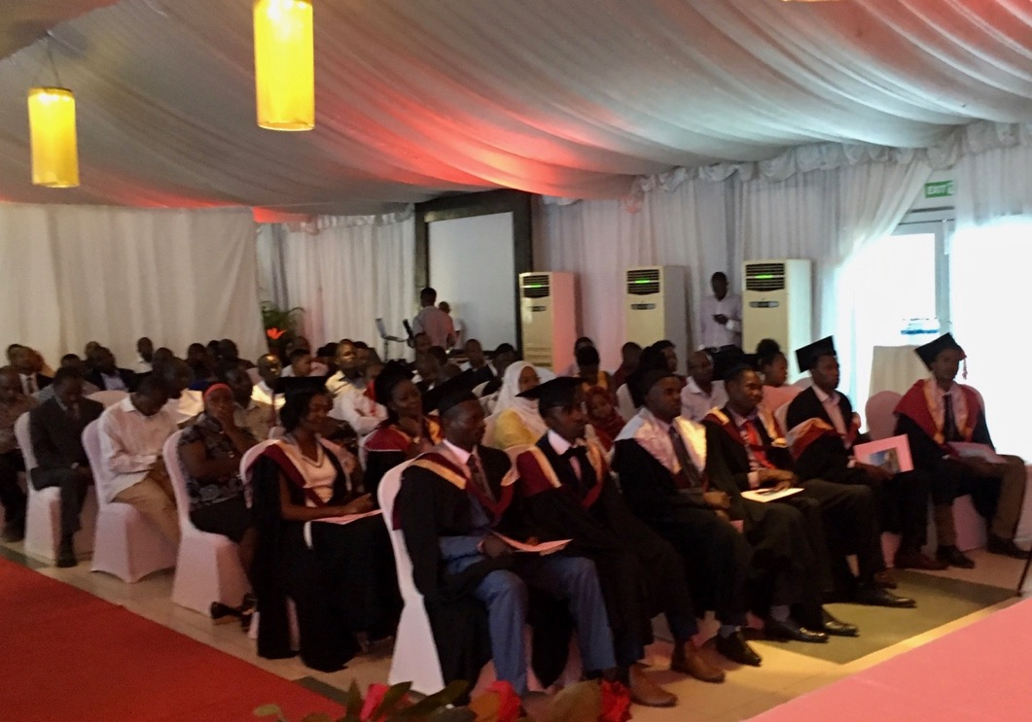
Fifth Anthei-EnPe Graduation

Slide 32
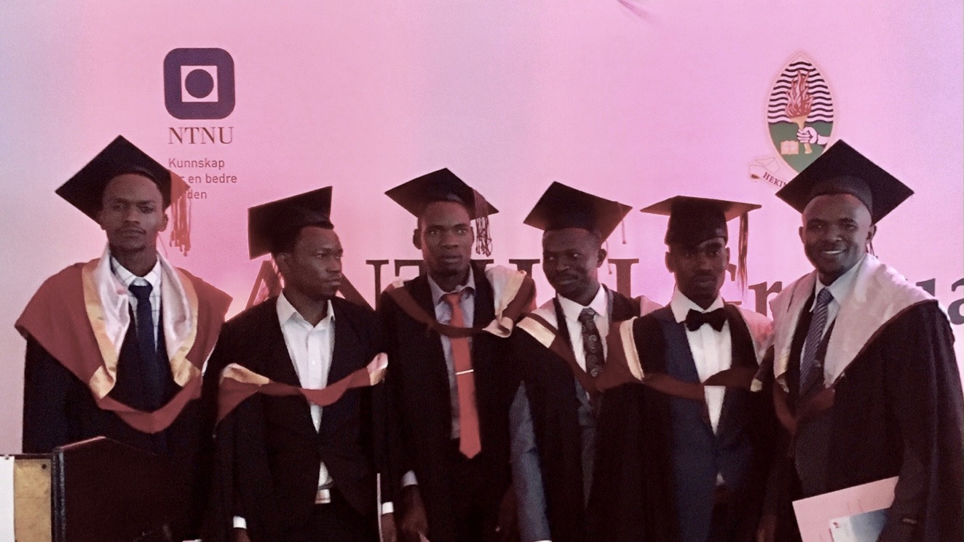
Fifth Anthei-EnPe Graduation

Slide 33
Anthei/EnPe 1st batch Graduates professional attachment
S/N | Name | Sex | Specialization | Employer
1 | Adela Sykilili | F | Petroleum Production | University of Dar es Salaam, Department of Chemical and Mining Engineering
2 | Oras Mkinga | M | Reservoir Engineering | University of Dar es Salaam, Department of Chemical and Mining Engineering
3 | Frida Andalu | F | Petroleum Production | University of Dar es Salaam, Department of Chemical and Mining Engineering
4 | Ghati Mwita | F | Petroleum Production | Equinor Tanzania
5 | Faustine Kasanda | M | Engineering | Schlumberger
6 | Neema Ernest | F | Petroleum Geosciences | Tanzania Petroleum Development Corporation (TPDC)
7 | Revocatus Kasheshi | M | Reservoir Engineering | Pan African Energy
8 | Morice Richard | M | Reservoir Engineering | University of Dar es Salaam, Department of Chemical and Mining Engineering
9 | Musa Ryoba | M | Petroleum Geosciences | Tanzania Petroleum Development Corporation (TPDC)
 | Juliet Antony | F | Production | Dar es Salaam Institute of Tech

Slide 34
Anthei/EnPe 2nd batch Graduates professional attachment
1 | Ernest Mulaya | M | Petroleum Geophysics | University of Dar es Salaam, Department of Geology
2 | Samwuel Lupyana | M | Drilling Engineering | University of Dodoma
3 | Mosa Moshi Masawani | F | Petroleum Geology | Maurel et Prom
4 | Godwin Nsemwa | M | Drilling Engineering | University of Dar es Salaam, Department of Chemical and Mining Engineering
5 | Vincent Edward Mosha | M | Petroleum Geosciences | Pan Africa Energy
6 | Sarah Mbwilo | F | Reservoir Engineering | Energy and Water Utilities Regulatory Authority (EWURA)
7 | Emily Barnabas Kiswaka | M | Petroleum Geophysics | University of Dar es Salaam, Department of Geology
8 | Juliana Mwalyepelo | F | Production Engineering | Desmi Africa Ltd
9 | Chone Malembo Lugangizya | M | Petroleum Geophysics | Mining Commission of Tanzania

Slide 35
Anthei/EnPe 3rd batch Graduates professional attachment
1 | Alex Willium Mwang’ande | M | Drilling Engineering | Mbeya University of Science and Technology
2 | Fred Robert Mkuyi | M | Drilling Engineering | University of Dar es Salaam, Department of Chemical and Mining Engineering
3 | Nyorobi Kiyuga Busanda | M | Reservoir Eng & Petrophysics | Equinor Tanzania
4 | Kennedy Geofrey Fikeni | M | Reservoir Eng & Petrophysics | University of Dodoma, School of Mines and Petroleum
5 | Adeltus N Rweyemamu | M | Reservoir Eng & Petrophysics | University of Dar es Salaam, Department of Chemical and Mining Engineering
6 | Anthony Richard Maswi | M | Reservoir Eng & Petrophysics | University of Dar es Salaam, Department of Chemical and Mining Engineering
7 | Eunice Jackson Wiswa | F | Petroleum Geosciences | Equinor Tanzania
8 | Idd Mussa Mchomvu | M | Petroleum Geosciences | Self Employed
9 | Shaban Marco Lutome | M | Petroleum Geophysics | University of Dodoma, School of Mines and Petroleum

Slide 36
Anthei/EnPe 4th batch Graduates professional attachment
1 | Zuhuru Nuru Mkindi | F | Reservoir Eng & Petrophysics | Dar es Salaam Institute of Technology
2 | Daniel Charles Rukonu | M | Drilling Engineering | University of Dodoma, School of Mines and Petroleum
3 | Tobias Isaya Magige | M | Reservoir Eng & Petrophysics | Ministry of Energy
4 | Alberto Joseph Cheru | M | Drilling Engineering | Dar es Salaam Institute of Technology
5 | Oltingei Lindi | M | Drilling Engineering | Mbeya University of Science and Technology
6 | Sameer Bajber Abdillah | M | Reservoir Eng & Petrophysics | University of Dodoma, School of Mines and Petroleum
7 | Adam Abdallah Makame | M | Petroleum Geosciences
8 | Maganga Sospeter Pastory | M | Reservoir & Petrophysics | University of Dodoma, School of Mines and Petroleum
9 | Faustin Matiku | M | Petroleum Geophysics | TPDC

