Slide 1



QUANTITATIVE RESERVOIR CHARACTERIZATION USING ROCK PHYSICS, SEISMIC AND GEOLOGICAL CONSTRAINTS – EXAMPLES FROM SEMLIKI BASIN IN ALBERTINE GRABEN
By
Nakajigo Joan
2016/HD13/18956U
BSc (GRM) MSc (PG)
Supervisors:
Dr. John Mary Kiberu
Department of Geology and Petroleum Studies (Makerere University)
Dr. Simon Echegu
Department of Geology and Petroleum Studies (Makerere University)
Dr. John Vianney Tiberindwa
Department of Geology and Petroleum Studies (Makerere University)
Prof. Tor Arne Johansen
Department of Earth Science (University of Bergen)
Presentation at EnPe Academic Sharing Seminar In Trondheim, Norway, On 26th -28th February 2018

Slide 2
Outline of the Presentation
Background
Objectives of the study
Significance of the study
Methodology
Results
Challenges

Slide 3

Introduction
Seismic reservoir characterization is important in hydrocarbon prospect evaluation and production.
There are a number of challenging problems causing uncertainties in the prediction results due to non-uniqueness and uncertainties in the input data.

Slide 4
Introduction
To increase the prediction capability we need to reduce the non-uniqueness by inferring geological constraints as a part of the analysis.
This study couples rock physics with geological constraints (burial history) and seismic to better delineate the reservoir properties of the reservoir unit in the Semliki basin with their uncertainties.

Slide 5
Introduction
Rock physics provides a link between geologic reservoir parameters (porosity, clay content, sorting, lithology, saturation) and seismic properties such as acoustic impedance, P-wave/S-wave. velocity ratio VP /VS, bulk density, and elastic moduli.
There are number of rock physics models Avseth, Mukerji, Mavko, and Dvorkin (2010); Avseth, Mukerji, & Mavko (2005) that are applied on particular rock type.

Slide 6
Introduction
Odegaard & Avseth (2004) developed rock physics templates as a tool to evaluate lithology and pore fluid interpretation of well logs based on theoretical rock physics trends for different lithologies expected in the area.
Inverse rock physics modelling (IRPM) was developed by Johansen, Jensen, Mavko & Dvorkin, (2013) to quantitatively analyze seismic data based on seismic inversion.

Slide 7
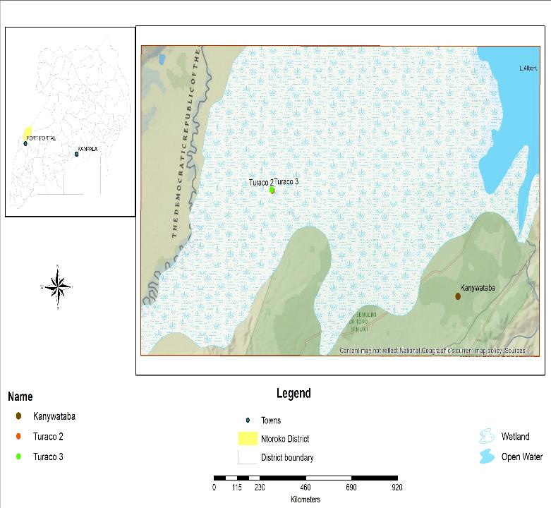
.
Semliki basin – Albertine Graben , western arm of the rift valley.
exploration stage
Currently, a number of fields are identified, drilling of appraisal wells is being done and approval of production license is ongoing

Slide 8
Problem Statement
The fundamental challenge in the Semliki Basin, is lack of a clear understanding of the distribution of various reservoir properties such as porosity, lithology and fluid saturation. It was evaluated that there exist traps however, the reservoirs have poor lateral distribution (Heritage 2004, CNOOC, 2012).This research purposes to use various methods to quantify the prevailing uncertainties in this basin. Burial history combined with RPM, IRPM and quantification of uncertainties in relation to facies distribution using probability distribution function (pdf) will be done for the first time in this basin.

Slide 9
Objectives of the study
Main Objective
To quantify the prevailing uncertainties in the determination of reservoir properties of the Albertine Graben.
Specific objectives
To determine the effect of burial history on seismic properties or signatures.
To establish the statistical relationship between reservoir properties.
To examine uncertainties in different reservoir property distribution.

Slide 10


Significance of the Research
This research will improve the overall understanding of the lateral internal structure of the study area and increase the predictability of several areas for well placement.
The use of burial history technique will allow the overall record of important events that occur in the sedimentary basin.
Rock physics modeling will aid in identification of appropriate model for the study area which can act as an input for future studies.
IRPM will improve prediction of reservoir quality both well location and inter-well regions.
This will add value to economy of Uganda by increasing new exploration prospecting areas and adding knowledge to this young industry.

Slide 11
Materials
3D seismic volume of Semliki basin
2D seismic of Semliki basin
A suite of well logs and check shots data including their field reports of Turaco
A suite of well logs and check shots data plus their field reports of Kanywataba.
Softwares: ENTER, Hampson Russell, Petromod & PELE.

Slide 12
Rock Physics modelling (RPM)
Use modelled parameters for burial history analysis
Visualization using RPT
(1)
Reservoir properties
(porosity, Lithology and fluid saturation
Well logs data
Seismic data
Litho cube
Porosity cube
Fluid cube
Monte Carlo
simulation
pdfs
(3)
IRPM
(2)
Seismic inversion
Bayesian classification
Seismic inversion
Forward RPM

Slide 13
RESULTS

Slide 14
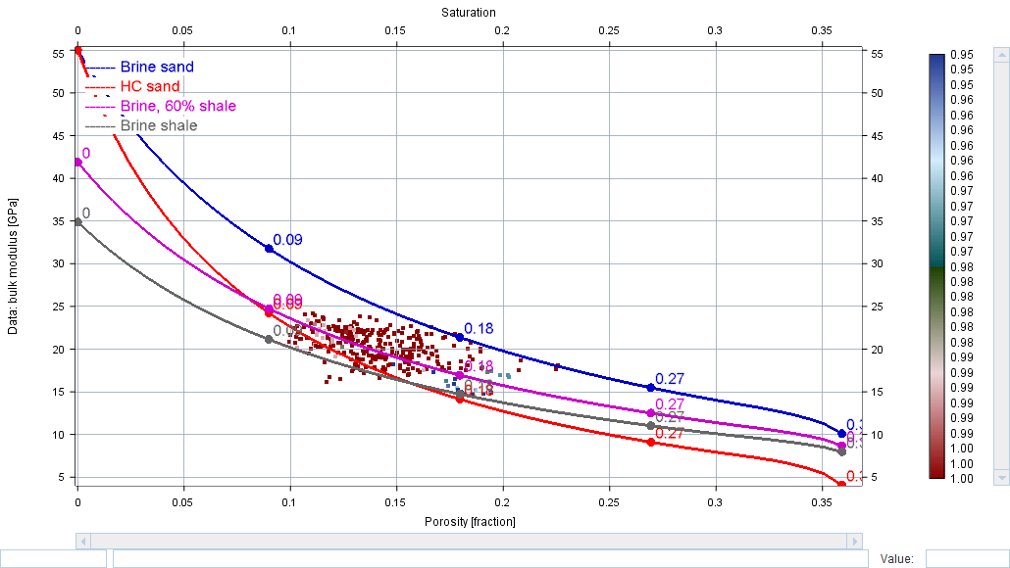
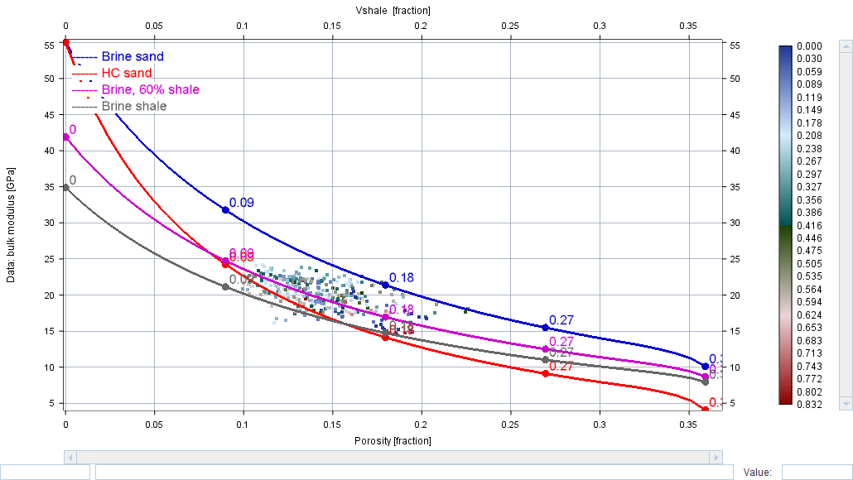
Constant cement model

Slide 15
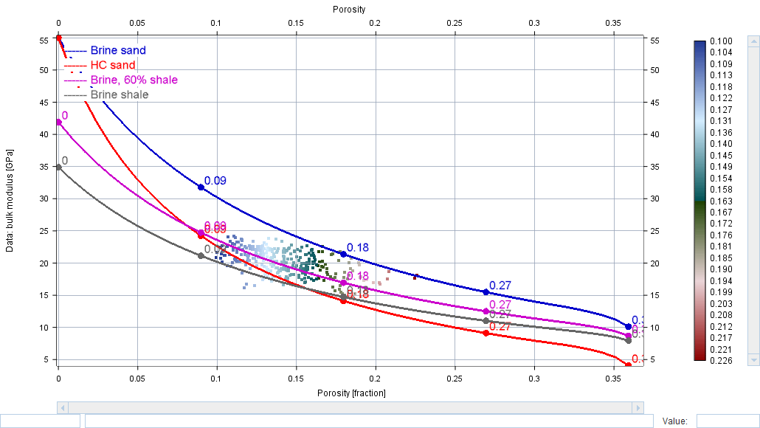


Slide 16
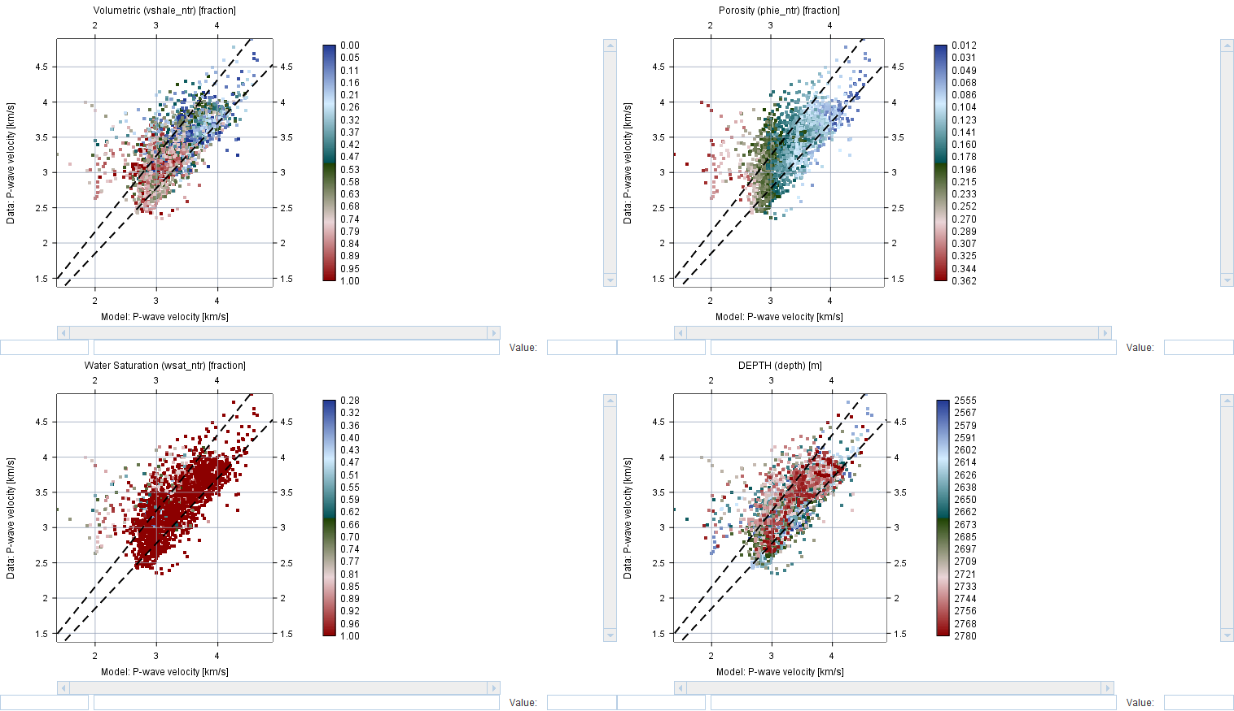
data vs model for Turaco 2

Slide 17
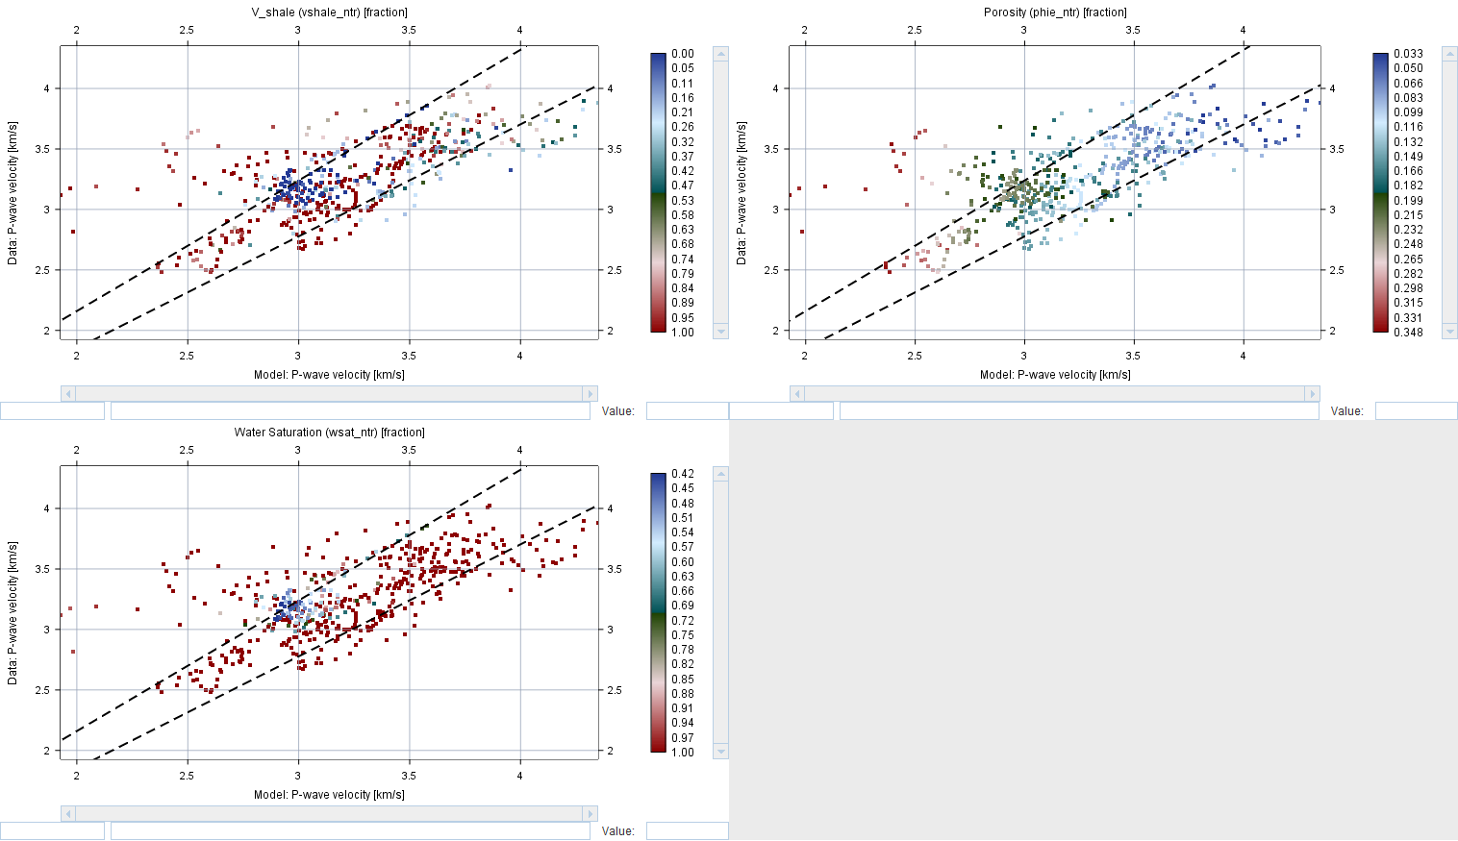
Turaco 3

Slide 18
RESULTS
The modelled parameters of Constant Cement model (bulk modulus, shear modulus, temperature, lithology among other) were used to determine;
Compaction state or phase,
Burial depth and
Amount of uplift.

Slide 19
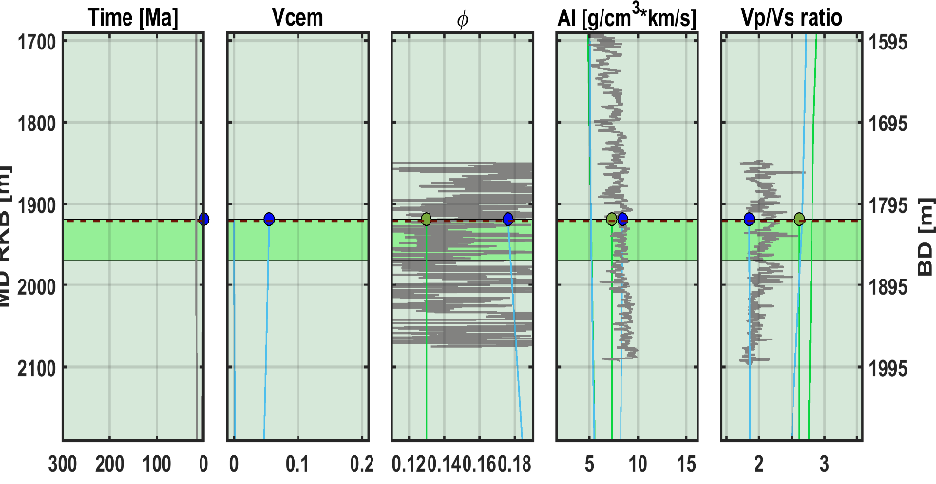
.
Prediction of seismic velocities over time for constant cement model. The analyzed formation has started chemical compaction

Slide 20
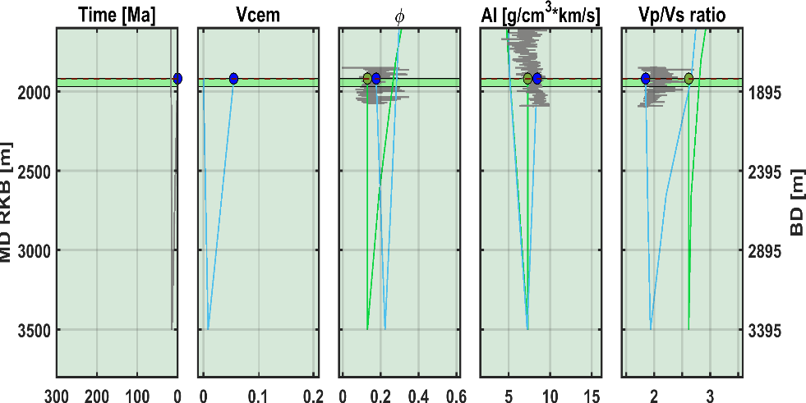
.
The analyzed formation indicate burial depth of 3500km and an uplift of 1596km

Slide 21
Challenges
The data had issues in that, it would not tally with theoretical trends hence data quality control had to be done.

Slide 22
REFERENCE
Avseth, P., Mukerji, T., Mavko, G., & Dvorkin, J. (2010). Rock-physics diagnostics of depositional texture, diagenetic alterations, and reservoir heterogeneity in high-porosity siliciclastic sediments and rocks—A review of selected models and suggested work flows. Geophysics, 75(5), 75A31-75A47.
Avseth, P., Mukerji, T., & Mavko, G. (2005). Quantitative Seismic interpretation: Cambridge University Press.
Avseth, P., & Odegaard, E. (2004). Well log and seismic data analysis using rock physics templates. First break, 22(10), 37-43.
HeritageOil&Gas. (2004). Final Well Geological Report for Turaco –2 Block 3, Albert Graben, Uganda. Department of Geology and Petroleum Studies, Makerere University.
Johansen, T. A., Jensen, E. H, Mavko, G. & Jack Dvorkin, J. (2013). Inverse modeling for reservoir quality prediction. GEOPHYSICS, Vol. 78 Issue (2), M1-M18. doi: 10.1190/geo2012-0215.
Yang, X., Yu, Y.,, & Dong, Y., Sun, Y.,. (2012). Final geological report of Kanywataba-l well in Kanywataba Exploration Area, Uganda. Department of Geology and Petroleum Studies, Makerere University

Slide 23

Acknowledgement
I would like to thank the EnPe project for funding this research and the Nowergian government as a whole.

Slide 24
Thank you for listening
.

