Slide 1




Project: ‘Research and Capacity Building in Clean and Renewable Bioenergy production and Utilization in Ethiopia’
Short name: Bioenergy-Ethiopia
Partners: Hawassa University (Dr. Meseret Tesema: Main coordinator)
Norwegian University of Life Sciences (Dr. Trine Hvoslef-Eide: Partner in Norway)
Mekelle University (Dr. Dereje A. Assefa: Partner at LMCI)
Supported by:

Slide 2
Outline of the Presentation
Project overview
Status of the New Academic programme
Research Activities and facilities in the project
Website and manuals developed
Research outputs
Impacts of lessons learnt on the programmes developed under EnPe II on other programmes run by the relevant Colleges and departments
A few key challenges and how they have been or are being addressed

Slide 3
Overview of the project
Initiated by 3 Partners
  2 LMIC partners (Hawassa University and Mekelle University, Ethiopia)
  1 Norwegian Partner (NMBU, Norway)

Slide 4
Goal of the Project:
To contribute towards sustainable use of clean and renewable bioenergy in Ethiopia
  through building research and teaching capacity of partner institutions in clean and renewable energy of bioenergy production and utilization

Slide 5
Objectives of the project:
1. Capacity building in clean and renewable bioenergy
  Higher education training
    Postdoc-1(2)
    PhD training-4
    MSc training-20
  Curriculum development at Hawassa University
2. Research in clean and renewable bioenergy
  Funding MSc thesis research-16
  Funding Staff research-5

Slide 6
1. Capacity Building.....
1-postdoc :
  Subproject1: ‘’Bioenergy production and utilization in rural Ethiopia: an analysis of contextual importance, policy perspectives, risks and opportunities, sustainability, and impacts on rural livelihood’’
  3 published papers in peer reviewed journals
4-PhD:
Subproject 2 (PhD-1): ’’Ecophysiological and Morphological Responses of Jatropha curcas L. accessions to major agroclimatic Zones of Ethiopia’’: Project manager: Shitaye D. Gebrewold
Subproject 3 (PhD 2): ’’Genetic diversity, Agronomic and biochemical characterization of Castor bean for potential biofuel production’’: Project manager: Lemlem S. Mekonnen/Dr Yemane Tsehaye…. As a postdoc.

Slide 7
Capacity Building.....
Subproject 4 (PhD-3): ’’Extraction of biofuel (seed oil) from Jatropha curcas L. from different agro-climatic zones of Ethiopia: the study of quantity and quality of biodiesel, and economic feasibility and implication for sustainable cultivation, production’’: Project manager: Yadessa Gonfa Keneni
Subproject 5 (PhD-4): ’’Identification of efficient and affordable technologies for sustainable production of biodiesel from different bio-energy sources Project manager’’: Project manager: Shimelis N. Gebremariam
7 papers have been published in peer reviewed journals (one added in 2019)
7 poster presentations

Slide 8
Academic program development...
New Master program has been developed
  ‘’Master of Science Degeree in Bioenergy Science and Technology’’
  Planned to enroll and graduate - 20 students
  Nine have been enrolled so far
    5 Female (55%)
    4 male

Slide 9
2. Research in clean and renewable bioenergy
Funding of MSc research related to Bioenergy
  15 students have been on MSc-reseach grants so far
  5 female (33%); 10 male (67%)
PhD Researchers – 4 from the start

Slide 10
Research Facilities
Mini-Biogas Digester and Gas Measurement plant has been established
Small Bioenergy lab is being established
  Lab equipments have been purchased and still being purchased

Slide 11
Manuals Developed
2 manuals developed so far
  1 Manual on mini-biogas digester construction and gas measurements
  1 Training manual on bioenergy and biogas

Slide 12
Research outputs …..
13 Master students who were recipients of the EnPe funding have graduated so far
Publications on peer reviewed Journals
  7 publications, 7 poster presentations
Manuals for training
  Renewable Energy training manuals
Mini biogas digester for demonstration for students and trainers

Slide 13
Few key challenges……
Challenges
  Delay in Enrolling students to the new Master program 'Master of Science in Bioenergy Science and Technology'
  PhD student dropped out of the project due to illness
  Dereje A: Assefa - Our partner from Mekelle University sadly passed away last year

Slide 14
Mitigation strategies
Assigning program leader has to handle the MSc programme independently
  The program has been launched and 9 students have been enrolled
We decided that the PhD research activity started should be handled as a postdoc research from Mekelle University by Dr. Yemane Tsehaye
We agreed with the Partner University (Mekelle University) for Dr. Yemane Tsehaye to take over the position as project leader in Mekelle

Slide 15
Expectations for the future (next 18 months)
Our 3 remaining EnPe PhD students are all doing well and they will all finish by the end of the project period, October 2020
The PhD student funded on NMBU project funds will also finish by Oct 2020
We expect to meet the goals for MSc student graduating (20 by Oct 2020)
We expect to publish 8-10 more peer reviewed papers

Slide 16
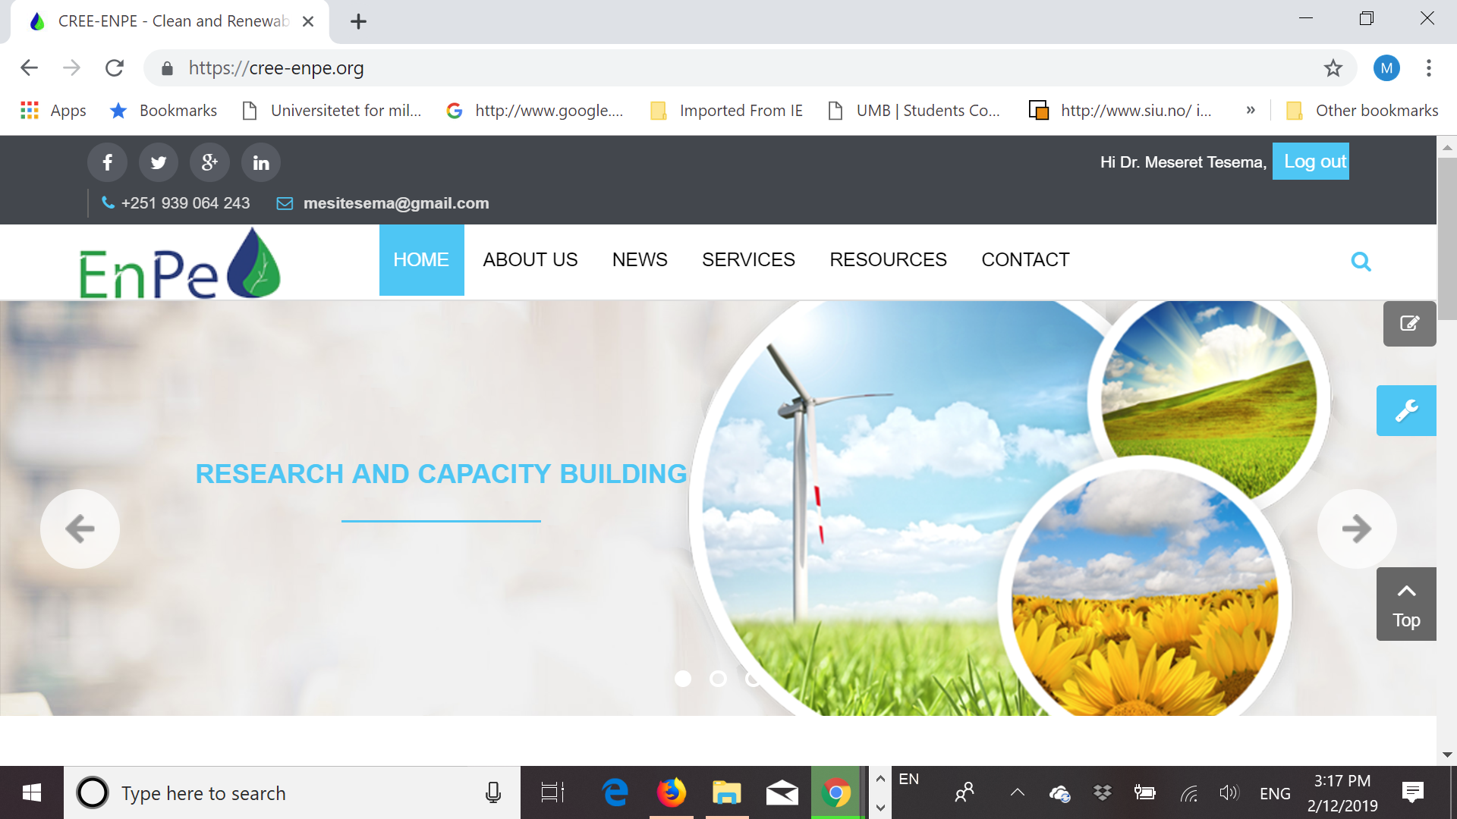
https://cree-enpe.org/

