Slide 1

ENPE RESEARCH AND ACADEMIC CONFERENCE
Date: 26th- 28th February, 2019
Venue: Scandic Nidelven, Trondheim

Slide 2



Project Name: Upgrading Education and Research Capacity in Renewable Energy Technologies (UPERCRET) 2015-2020
Project Host: The Kwame Nkrumah University of Science and Technology, Kumasi

Slide 3
The Partnership
The Brew-Hammond Energy Center (TBHEC) of the Kwame Nkrumah University of Science and Technology (KNUST), Kumasi, Ghana
Department of Ecology and Natural Resource Management (INA), Norwegian University of Life Sciences(NMBU), As, Norway
Department of Ocean Operations Civil Engineering,Norwegian University of Science and Technology, Alesund, Norway.

Slide 4
The Coordinators
Ing. Dr. Lena Dzifa Mensah (Ms)
The Brew-Hammond Energy Center, (TBHEC), Dept. of Mech. Engineering KNUST, Kumasi, Ghana
Tel: +2330207065185
Email: ldmensah.coe@knust.edu.gh
ld.mensah@yahoo.com
Prof. Muyiwa S. Adaramola
Department of Ecology and Natural Resource Management (INA), Norwegian University of Life Sciences, Norway
Email: muyiwa.adaramola@nmbu.no
Tel: +47-64965793
Prof. Razak Seidu
Department of Ocean Operations Civil Engineering,
Norwegian University of Science and Technology, Alesund, Norway
rase@ntnu.no
Tel: +47 936 97 921

Slide 5
Presentation Outline
Background & Overview of the MSc. RETs Programme
Project Goal & Project Objectives
Achievements of the Project
Overview of Academic Programmes
Some Pictures from Programmes Organized and Meetings

Slide 6
Background & Overview of MSc. RETs Programme
One of the key challenges to realizing sustainable energy systems in Sub-Saharan Africa is the lack of personnel with the requisite knowledge and skill in the area of renewable energy technologies.
A realization by Ghana that over reliance on our hydro dam could not serve our energy needs
Development of initiatives to diversify our sources of energy
A gap – initiatives neglected the knowledge and skill requirements to develop and sustain such alternative energy systems

Slide 7
Background & Overview of MSc. RETs Programme Contd.
The Energy Center set up the MSc. in Renewable Energy Technologies in 2011 to help build a critical mass of professionals in Sub-Saharan Africa with in-depth knowledge and skills in:
RE technologies and policies
Policies related to energy access and efficiency

Slide 8
Overview of the Existing MSc. RETs Programme
Programme Duration: One and a half years (3 semesters)
  Comprising two semesters of course work via e-learning
  One semester of thesis
  A 3 - week residential session on KNUST campus for laboratory work and examination
Core and Elective Courses Offered
Energy Policy & Planning (c) | Energy & Environment (c)
Solar Thermal Technology (c) | Solar PV Technology (c)
Bio-energy Technology (c) | Liquid Biofuel Production Systems (E)
Wind Power Technology (c) | Biogas Technology (E)
Project Management (c) | Small Hydropower Technology (c)
Research Methods (c) | Renewable Energy Project Analysis (c)
Hybrid Electric and Grid- Connected Systems (E) | Renewable Energy Project Implementation (c)

Slide 9

Key Challenges Faced by MSc. RETs
Insufficient capacity of the academic staff (in terms of staff numbers, and staff with PhDs) to adequately provide supervision/advice to students during their thesis works. This delayed students’ timely graduation
Insufficient laboratory equipment and materials for education and research for the programme
Low female enrollment in general

Slide 10
UPERCRET PROJECT GOAL
To upgrade KNUST's capacity to deliver globally competitive education and research in the field of renewable energy technologies and policy to build critical mass of experts within renewable energy technologies in Ghana and sub-Saharan Africa

Slide 11
Project Objectives
Enhanced procedures and guidelines for student’s timely graduation
To enhance the academic, technical and administrative capacity of staff
Increase female participation in course delivery, programme management, and student enrollment
Increase collaboration and engagement with industry, government and professional institutions
Improve laboratory infrastructure and research output of staff (Publications)
Enhance relevance of programme content to national and sub-regional energy priorities
Revising the existing MSc. RETs programme

Slide 12
Achievements of the Project so Far

Slide 13
Improvement in Graduation Rates
 | Period | Students Admitted | Graduated | Percentage
Pre-project | 2011-2014 | 113 | 20 | 18%
Project Phase | Backlog from | 93 | 25 | 23.20%
 | 2011-2014
 | 2015 | 19 | 8 | 42%
 | 2016 | 11 | 5 | 45%
 | 2017 | 9 | ? | ?
 | 2018 | 8 | ? | ?
* 10 students are awaiting oral defense in June

Slide 14
Improvement in Graduation Rates Contd
Orientation programmes instituted to introduce students to requirements for graduation and other procedures relevant to successful completion of their course.
-Co-supervision system introduced
-Penalties instituted to motivate students to complete on time
Seminars organized to monitor progress of students on their thesis

Slide 15
Enhanced Capacity of Academic Staff
Two new lecturers added to lecturers (external tutors)
Dept agreed to allow external partners to co-supervise with KNUST staff
Staff from outside of the College of Engineering now being involved in student thesis supervision
One academic staff undertaking a post-doc at NMBU
8 PhDs being trained will also participate in the supervision of students.

Slide 16
Enhanced Capacity of Technical and Administrative Staff
Five teaching and research assistants ( 3 males and 2 females ) have been trained in Solar Photovoltaic Systems (Intensive One Week Short Course)
Another set of 8 teaching and research assistants are set to be trained in various renewable energy technologies system design and tools and techniques for analysis in May, 2019
One administrative staff trained in Project Management and Effective Office Management and Administration at the Center for IT Professional Development and the University of Ghana Business School respectively.

Slide 17
Increased Female Participation in Course Delivery and Management
One female involved in programme management
3 females currently involved in course delivery
Also counting on the lifting of GoG ban to allow for more opportunities to employ female engineering staff

Slide 18
Enrolment for MSc./MPhil
Year | No. Admitted | Female | International
2011 | 48 | 3 | 2
2012 | 20 | 0 | 0
2013 | 21 | 4 | 2
2014 | 24 | 1 | 0
2015 | 19 | 1 | 3
2016 | 11 | 0 | 0
2017 | 10 | 1 | 0
2018 | 8 | 3 | 0

Slide 19
Increased Female Participation in Course Enrolment
6% in the 2015-2016 academic year
0% in the 2016-2017 academic year
11% in the 2017/2018 academic year
33% in the 2018/2019 academic year
? % in the 2019/2020 academic year
8 PhDs
25% females

Slide 20
PhD Enrollment
PhD Student | Location/Registration | Title of PhD project | Supervisors | Expected completion year
Maame Tabuah Ankoh (F) | KNUST, Kumasi, Ghana | Experimental determination impact of soiling on solar PV performance | Dr. Rueben Tamakloe Dr. Lena Dzifa Mensha Prof. Muyiwa S Adaramola | 2020
Emmanuel Yeboah Osei | KNUST, Kumasi, Ghana | Optimization of Wind Turbine Blade Profile for Low Wind Speed Application | Dr. Albert K Sunnu Dr. Richard Opoku Prof. Muyiwa S. Adaramola | 2020
Fabrice Abunde Neba | NTNU, Ålesund, Norway | Model-based synthesis for optimal operation of methane bioreactors: bioenergy generation and waste management | Prof. Razak Siedu Prof. John Morken Prof. Ahmad Ado Dr. NanaYaw Asiedu | 2020
25% female participation

Slide 21
PhD Enrollment
PhD Student | Location/Registration | Title of PhD project | Supervisors | Expected completion year
Denis Edem Kwame Dzebre | NMBU, Ås, Norway | Wind Resource Assessment in Ghana with Mesoscale and Microscale Models | Prof. Muyiwa S Adaramola | 2019
 |  |  | Dr. Joshua Ampofo
 |  |  | Dr. Akwasi A Acheampong
Frank Kwabena Afriyie Nyarko | KNUST, Kumasi, Ghana | Modelling interconnections in c-Si Solar Photovoltaic modules for improved reliability in sub-Saharan Africa. | Dr. Gabriel Takyi | 2019
 |  |  | Dr. Emeka Amalu
 |  |  | Prof. Muyiwa S Adaramola
Gloria Boafo-Mensah | KNUST, Kumasi, Norway | Design and construction of efficient biomass cookstove for clean cooking | Dr. Lawrence Darkwah | 2020
 |  |  | Dr. Mensah Darwah
 |  |  | Dr. Francis Kkemausuor
 |  |  | Prof. Razak Seidu
Saeed Abdul-Ganiyu | NMBU, Ås, Norway | Performance analysis and enhancement of hybrid photovoltaic /thermal (pv/t) solar systems | Prof. Muyiwa S Adaramola | 2020
 |  |  | Prof. Seidu Razak
 |  |  | Dr. Emmanuel W Ramde
Ebenezer Nyarko Kumi | NTNU, Ålesund, Norway | Design of a Solar-Powered Electro-Flocculation Unit for Drinking Water Treatment | Prof. Razak Seidu Prof. John Morken Dr. Emmanuel W. Ramde Dr. Mrs.Eunice Akyereko Adjei

Slide 22
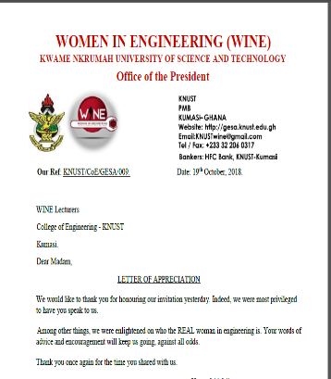
Initiatives Undertaken to Increase Female Enrollment
Developed engagement materials (fliers, pull-ups, posters) to publicize programmes
Website adverts
Participation of a delegation each year in the Women in Engineering programmes and conferences
Involvement in mentoring programmes at the College of Engineering level & university level
Ghana Compact Internship and Mentoring Programme (GIMP), Millennium Development Authority (MiDA)

Slide 23
Initiatives Undertaken to Increase Female Enrollment
Gender mainstreaming conference as part of the UPERCRET Project at KNUST
Proposed dates: (May/June)
Proposed venue: IDL conference Centre, KNUST, Ghana
Target participants: All units – KNUST, Selected Research Institutes in Ghana, Public and Private Universities in Ghana
Some Topics to be presented on include:
Mainstreaming Gender in Higher Education and Research in Ghana
Getting it right; Setting the stage for Gender Mainstreaming; what are the requirements?
Gender mainstreaming in public policies
Mainstreaming gender in curriculum development, teaching and research
Some Topics to be discussed include:
Group 1: Theory vrs practice (Gender mainstreaming in higher education and Research
Group 2: Institutional requirements for gender mainstreaming in higher education and Research
Group 3: Strategies for sustaining gender equality in higher education and Research

Slide 24
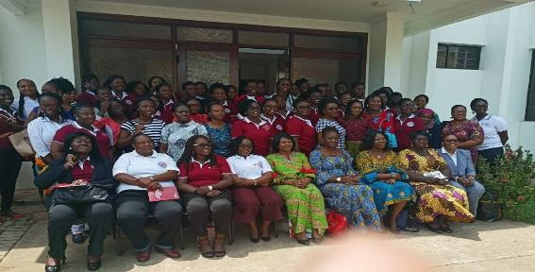
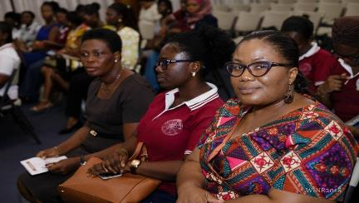
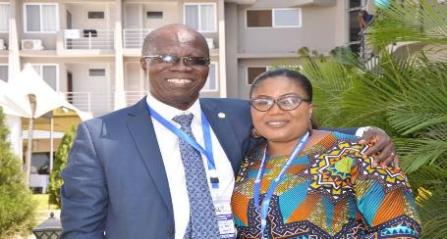
Initiatives Undertaken to Increase Female Enrollment
Some Pictures from 2017 GHiE WINE

Slide 25

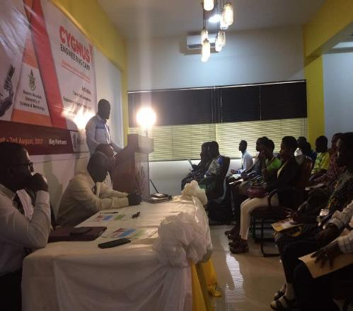
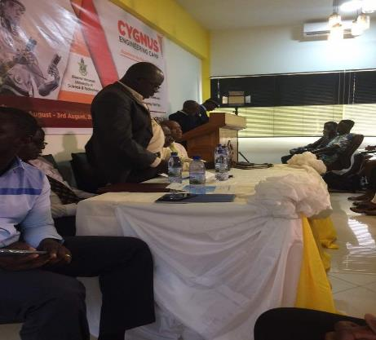

Slide 26
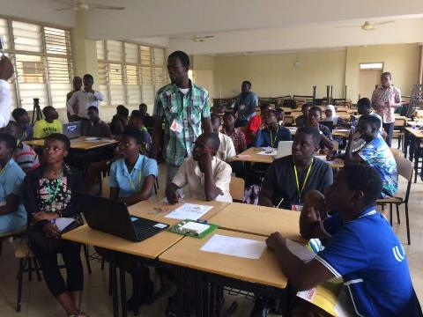
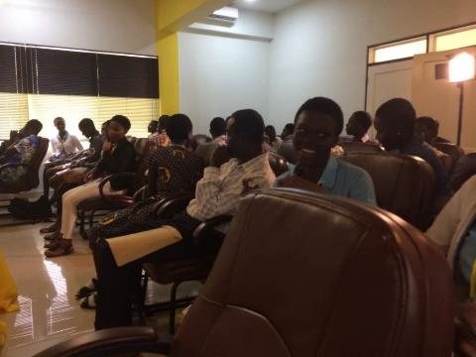
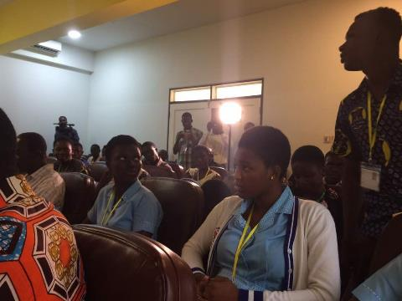
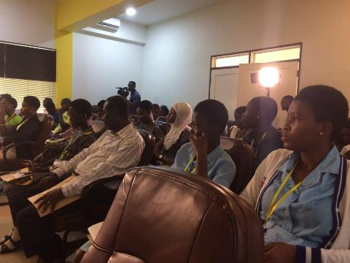

Slide 27
Increased Linkages and Engagement with Industry Government, and Professional Institution Industry
An 8 member Advisory Board established
- team comprises representatives from the Ministry of Power, Regulators, I - Industry Practitioners and an Alumnus of the MSc RETs programme.
Their role:
- to review programme documents and provide input into curriculum development to enhance relevant to national need and industry.
Team participated in the project lunch, and review of newly developed programmes.

Slide 28
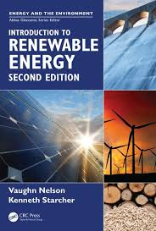
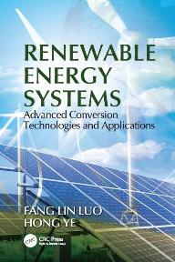
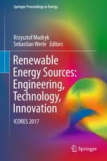
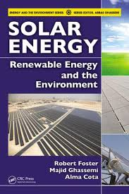
Procurement of Text Books
At the time of project launch we had 6- renewable energy related text book.
90 energy and renewable energy text books to be stocked in the College of Engineering Library

Slide 29
Workstations
2 high profile workstations
10 laptops
A dedicated server to host Software for online teaching and other software packages

Slide 30
Improved Infrastructure for Research
Refurbishment of existing facilities
Wind tunnel on the KNUST campus
Sinks for sample processing at the bio-energy laboratory
Procurement of a fridge to store samples
Procurement of PPE for use in the labs
Some consumables for the labs

Slide 31
Overview of Academic Programmes
- The 18-month MSc. Renewable Energy Technologies (MSc. RETs) programme was revised to 12-month (Two Semesters)
- A new 24-month MPhil in Renewable Energy Technologies (MPhil) Programme was developed
- A new 48-month PhD in Sustainable Energy Technologies (PhD SETs) was developed

Slide 32
MSc. Renewable Energy Technologies (MSc. RETs)- Entry Requirements
General Qualifications
Applicants with a minimum of second class lower degree or its equivalent from a recognised university in the following areas:
BSc Engineering;
BSc Physics, BSc Chemistry, BSc Environmental Science.
Programme Requirements
Candidates must have a minimum of two years working experience in the renewable energy industry;
In addition, candidates with second class lower degrees must pass a selection interview.

Slide 33

Assessment and Graduation Requirement
Assessment Requirements
The assessment of the students are based on the following forms:
Written exercises, Oral presentations, Quizzes, Written examination.
Continuous Assessment
- 40% comprises of quizzes, take home assignments, oral presentations and mid-semester examination.
End of Semester Examination
- 60% of the overall assessment and will be written under formal examination conditions at the end of the semester
Graduation Requirements
For the award of the MSc RETs, the student must have:
obtained a minimum pass mark of 50 % in any examination;
achieved a minimum total credit of 36 credit hours;
obtained a minimum CWA of 55.00;
IV. Submitted and successfully defended a thesis

Slide 34

Overall Course Structure
Year One Semester One Courses: Courses
Course Code | Course Title | T | P | C
RET 551 | Introduction to RE Technologies | 2 | 2 | 3
RET 553 | Entrepreneurship and Small Business Management | 2 | 2 | 3
RET 555 | Energy Policy, Gender and Planning | 3 | 0 | 3
RET 557 | Energy and Environment | 2 | 2 | 3
Sub-Total |  | 9 | 6 | 12
Elective Courses – Students are to select two courses from the following
Course Code | Course Title | T | P | C
RET 571 | Liquid Biofuel Production Systems | 2 | 2 | 3
RET 573 | Biogas Technology | 2 | 2 | 3
RET 575 | Solar Thermal Technology | 2 | 2 | 3
RET 577 | Small Hydropower Technology | 2 | 2 | 3
Sub-Total |  | 4 | 4 | 6
Total |  | 13 | 10 | 18

Slide 35
Overall Course Structure Contd.
Year One Semester Two: Core Courses
Course Code | Course Title | T | P | C
RET 550 | Research Methods | 2 | 2 | 3
RET 554 | Project Analysis and Management | 2 | 2 | 3
RET 556 | Renewable Energy Laboratory | 1 | 4 | 3
RET 598 | Research Project | 0 | 6 | 3
Sub-Total |  | 5 | 14 | 12
Elective Courses: Students are required to select two courses from the following
Course Code | Course Title | T | P | C
RET 572 | Solar PV Technology | 2 | 2 | 3
RET 574 | Wind Power Technology | 2 | 2 | 3
RET 576 | Bio-energy Technology | 2 | 2 | 3
RET 578 | Hybrid Energy Systems | 2 | 2 | 3
Sub-Total |  | 4 | 4 | 6
Total |  | 9 | 18 | 18

Slide 36
Employment Opportunities
A significant percentage of our graduates are already employed, however, for the few who may be looking for jobs, employment opportunities exist in the following areas:
Generation Companies like the Volta River Authority, and Aboadze Thermal Power Company;
Government Ministries like the Ministry of Energy and the Ministry of Power;
Regulatory institutions in the Ghana and the West African sub-region like the West Africa Power Pool, the Energy Commission of Ghana, the Public Utilities and Regulatory Commission;
Set up their own renewable energy firms.

Slide 37
MPhil Renewable Energy Technologies (MPhil. RETs)- Entry Requirements
General Qualifications
Applicants with a minimum of second class lower degree or its equivalent from a recognised university in the following areas:
BSc Engineering;
BSc Physics, BSc Chemistry, BSc Environmental Science.
Programme Requirements
Candidates must have a minimum of two years working experience in the renewable energy industry;
In addition, candidates with second class lower degrees must pass a selection interview.

Slide 38
Assessment and Graduation Requirement
Assessment Requirements
The assessment of the students are based on the following forms:
Written exercises, Oral presentations, Quizzes, Written examination.
Continuous Assessment
- 40% comprises of quizzes, take home assignments, oral presentations and mid-semester examination.
End of Semester Examination
- 60% of the overall assessment and will be written under formal examination conditions at the end of the semester
Graduation Requirements
For the award of the MPhil RETs, the student must have:
obtained a minimum pass mark of 50 % in any examination;
achieved a minimum credit of 57 credit hours;
obtained a minimum CWA of 55.00; and
submitted and successfully defended a dissertation.

Slide 39
Overall Course Structure for the
MPhil RETs
Year One Semester One Courses: Courses
Course Code | Course Title | T | P | C
RET 551 | Introduction to RE Technologies | 2 | 2 | 3
RET 553 | Entrepreneurship and Small Business Management | 2 | 2 | 3
RET 555 | Energy Policy, Gender and Planning | 3 | 0 | 3
RET 557 | Energy and Environment | 2 | 2 | 3
Sub-Total |  | 9 | 6 | 12
Elective Courses – Students are to select two courses from the following
Course Code | Course Title | T | P | C
RET 571 | Liquid Biofuel Production Systems | 2 | 2 | 3
RET 573 | Biogas Technology | 2 | 2 | 3
RET 575 | Solar Thermal Technology | 2 | 2 | 3
RET 577 | Small Hydropower Technology | 2 | 2 | 3
Sub-Total |  | 4 | 4 | 6
Total |  | 13 | 10 | 18

Slide 40
Overall Course Structure Contd.
Year One Semester Two: Core Courses
Course Code | Course Title | T | P | C
RET 550 | Research Methods | 2 | 2 | 3
RET 554 | Project Analysis and Management | 2 | 2 | 3
RET 556 | Renewable Energy Laboratory | 1 | 4 | 3
Sub-Total |  | 7 | 10 | 9
Elective Courses: Students are required to select two courses from the following
Course Code | Course Title | T | P | C
RET 572 | Solar PV Technology | 2 | 2 | 3
RET 574 | Wind Power Technology | 2 | 2 | 3
RET 576 | Bio-energy Technology | 2 | 2 | 3
RET 578 | Hybrid Energy Systems | 2 | 2 | 3
Sub-Total |  | 4 | 4 | 6
Total |  | 9 | 18 | 18

Slide 41
Overall Course Structure Contd.
Year Two Semester One:
Course Code | Course Title | T | P | C
RET 697 | Research Project I | 0 | 24 | 12
 | Total | 0 | 24 | 12
Year Two Semester Two
Course Code | Course Title | T | P | C
RET 698 | Research Project II | 0 | 24 | 12
 | Total | 0 | 24 | 12

Slide 42
Employment Opportunities
A significant percentage of our graduates are already employed, however, for the few who may be looking for jobs, employment opportunities exist in the following areas:
Teach in the Technical Universities
Generation Companies like the Volta River Authority, and Aboadze Thermal Power Company;
Government Ministries like the Ministry of Energy and the Ministry of Power;
Regulatory institutions in the Ghana and the West African sub-region like the West Africa Power Pool, the Energy Commission of Ghana, the Public Utilities and Regulatory Commission.

Slide 43
PhD Sustainable Energy Technologies (PhD SETs)- Entry Requirements
General Qualifications
Applicants with good master’s or MPhil degree in Engineering or related field from a recognized University
Submit PhD proposal to be assessed
In addition, candidates must pass an interview.
.

Slide 44
Assessment and Graduation Requirement
Assessment Requirements
The assessment of the students are based on the following forms:
Written exercises, Oral presentations, Quizzes, Written examination.
Continuous Assessment
- 40% comprises of quizzes, take home assignments, oral presentations and mid-semester examination.
End of Semester Examination
- 60% of the overall assessment and will be written under formal examination conditions at the end of the semester
Graduation Requirements
For the award of the PhD SETs, the student must have:
Obtained a minimum pass mark of 50% in any examination;
Obtained a minimum pass mark of 65% in in a comprehensive examination;
achieved a minimum credit of 112 credit hours;
obtained a minimum CWA of 55.00;
submitted at least two publications from thesis in a reputable journal; and
submitted and successfully defended a Thesis.

Slide 45
Overall Course Structure
Year One Semester One Courses: Courses
Course Code | Course Title | T | P | C
RET 551 | Introduction to RE Technologies | 2 | 2 | 3
RET 553 | Entrepreneurship and Small Business Management | 2 | 2 | 3
RET 555 | Energy Policy, Gender and Planning | 2 | 2 | 3
RET 557 | Energy and Environment | 2 | 2 | 3
Sub-Total |  | 8 | 8 | 12
Elective Courses – Students are to select one course from the following
Course Code | Course Title | T | P | C
RET 571 | Liquid Biofuel Production Systems | 2 | 2 | 3
RET 573 | Biogas Technology | 2 | 2 | 3
RET 575 | Solar Thermal Technology | 2 | 2 | 3
RET 577 | Small Hydropower Technology | 2 | 2 | 3
Sub-Total |  | 4 | 4 | 6
Total |  | 13 | 10 | 18

Slide 46
Overall Course Structure Contd.
Year One Semester Two: Core Courses
Course Code | Course Title | T | P | C
RET 550 | Research Methods | 2 | 2 | 3
RET 554 | Project Analysis and Management | 2 | 2 | 3
Sub-Total |  | 4 | 4 | 6
Total |  | 4 | 4 | 6
Elective Courses: Students are required to select one course from the following
Course Code | Course Title | T | P | C
RET 572 | Solar PV Technology | 2 | 2 | 3
RET 574 | Wind Power Technology | 2 | 2 | 3
RET 576 | Bio-energy Technology | 2 | 2 | 3
RET 578 | Hybrid Energy Systems | 2 | 2 | 3
Sub-Total |  | 4 | 4 | 6
Total |  | 9 | 18 | 18

Slide 47
Overall Course Structure Contd.
Year Two Semester One:
Course Code | Course Title | T | P | C
RET 697 | Thesis I | 0 | 24 | 12
RET 691 | Seminar I | 0 | 4 | 2
Sub-Total |  | 0 | 28 | 14
Total |  | 0 | 28 | 14
Year Two Semester Two
Course Code | Course Title | T | P | C
RET 698 | Thesis II | 0 | 24 | 12
RET 692 | Seminar II | 0 | 4 | 2
Sub-Total |  | 0 | 28 | 14
Total |  | 0 | 28 | 14

Slide 48
Overall Course Structure Contd.
Year Three Semester One:
Course Code | Course Title | T | P | C
RET 897 | Thesis III | 0 | 24 | 12
RET 891 | Seminar III | 0 | 4 | 2
Sub-Total |  | 0 | 28 | 14
Total |  | 0 | 28 | 14
Year Three Semester Two
Course Code | Course Title | T | P | C
RET 898 | Thesis IV | 0 | 24 | 12
RET 892 | Seminar IV | 0 | 4 | 2
Sub-Total |  | 0 | 28 | 14
Total |  | 0 | 28 | 14

Slide 49
Overall Course Structure Contd.
Year Four Semester One:
Course Code | Course Title | T | P | C
RET 997 | Thesis V | 0 | 24 | 12
RET 991 | Supervised Teaching I | 1 | 8 | 4
Sub-Total |  | 1 | 32 | 16
Total |  | 1 | 32 | 16
Year Four Semester Two
Course Code | Course Title | T | P | C
RET 998 | Thesis VI | 0 | 24 | 12
RET 992 | Supervised Teaching II | 1 | 8 | 4
Sub-Total |  | 1 | 32 | 16
Total |  | 1 | 32 | 16
Grand Total |  | 30 | 204 | 112

Slide 50
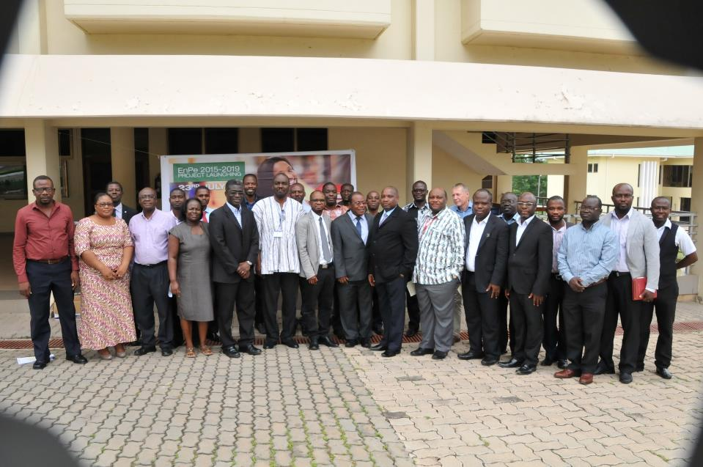
Some Pictures from the Project

Slide 51
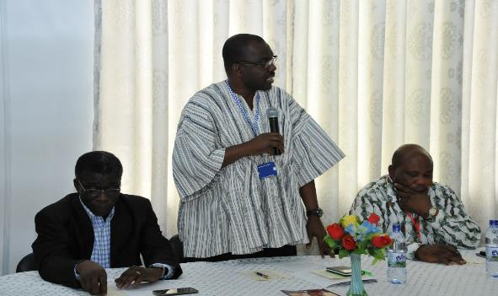
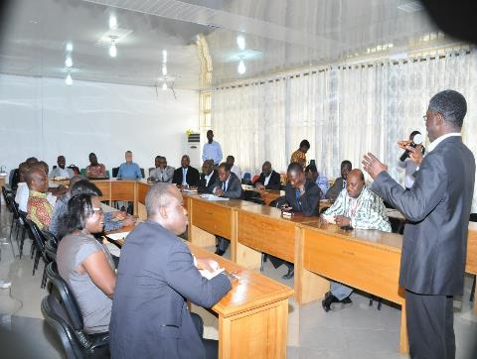
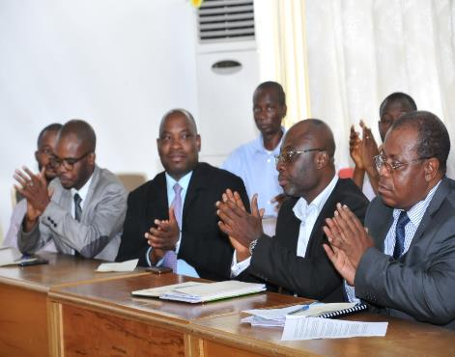

Slide 52
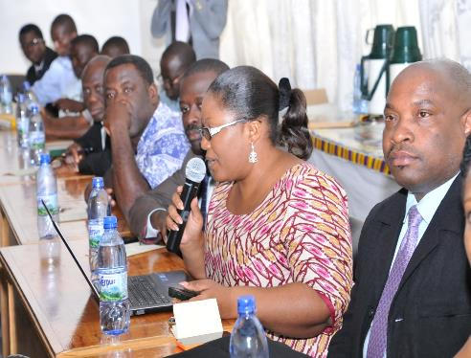
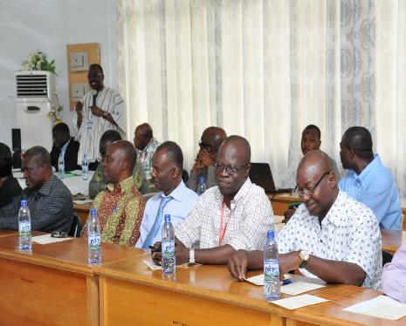
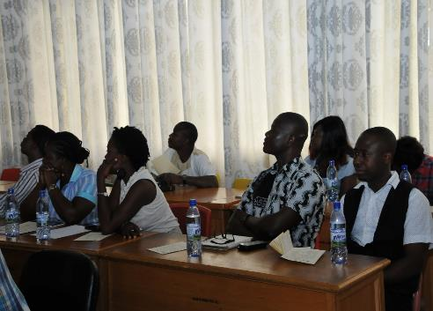
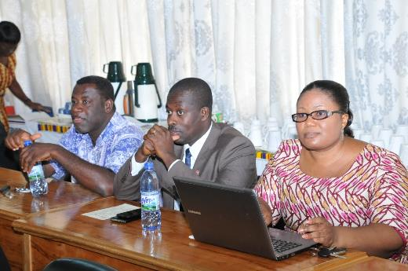

Slide 53
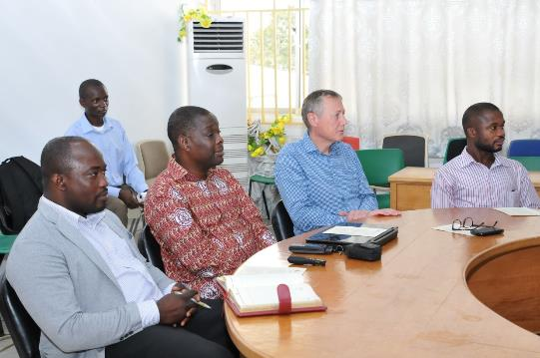
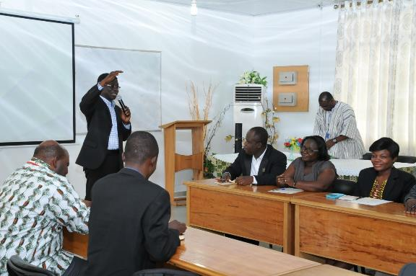
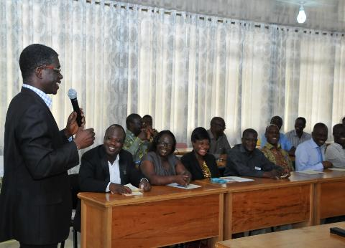

Slide 54
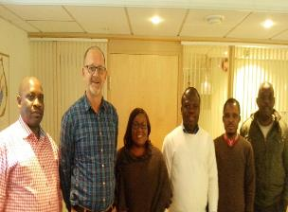
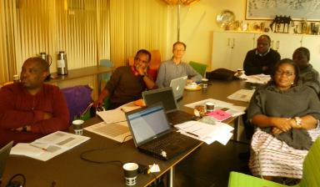
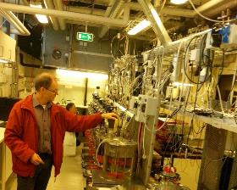
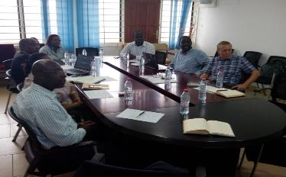
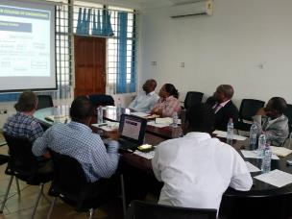
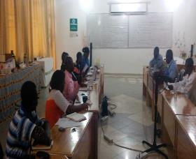
Some Pictures for the Reciprocal Visits by Project Partners
In Norway
In Ghana

Slide 55
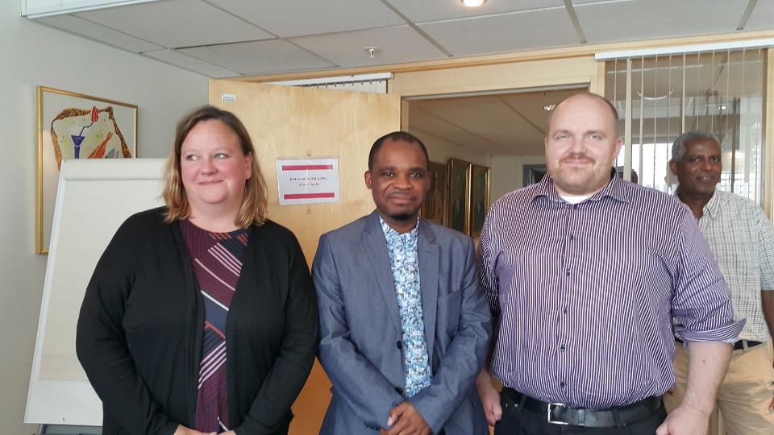

Slide 56
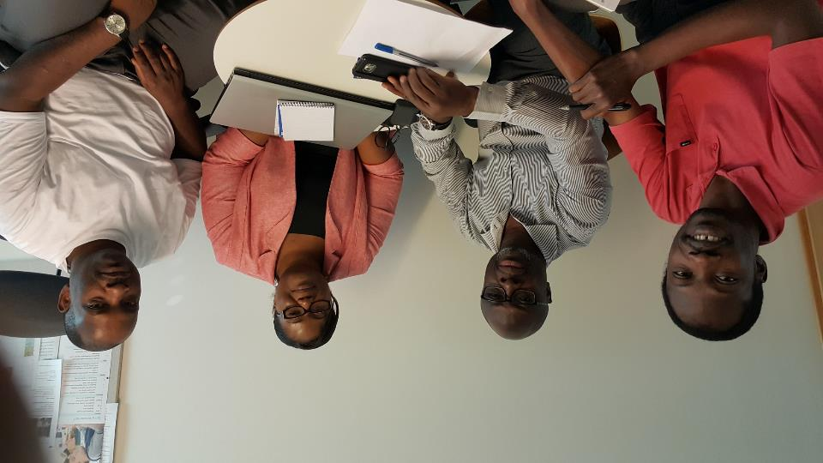

Slide 57
Thank you!

